Slide 1
Data Mining
Sandra Fernando
Connolly and Begg, 2002,Database System 4th Edition, Chapter 34

Slide 2
What is Data mining?
The process of extracting valid, previously unknown, comprehensible and actionable information from large database and using it to make crucial business decision.
A knowledge discovery process of automated extraction of hidden patterns/behaviours and predictive information from large datasets/databases/data warehouses .

Slide 3
Data Mining Process
Business Understanding and Data understanding: Converts the business problem in to Data mining problem. Collect initial data, explore data, verify data quality
Data set preparation: Select Data, Clean Data, construct data, integrate data, format data
Modeling /Discovery of patterns: Selecting modelling technique, modelling parameters and assessing the model created. Select modelling technique, generate test data, build model, assess model
Evaluation and Deployment: The phase validates the model. Evaluate results, review process determine next step. During the deployment the knowledge gained from the model needs to be organised and presented using reports or repeatable phases across the enterprise.

Slide 4
What is Data Mining?
Data Cleansing
Data Integration
Data Selection and Transformation
Data Mining
Pattern Evaluation
Knowledge Presentation
Notes:
Data mining is the procedure of mining knowledge from data.
How do you do each stage ? What tools are in use?
https://www.kdnuggets.com/2011/04/free-tools-data-visualization-analysis.html
DM Tools: Weka, Xlminer,R, Cementine, SQL Server Analysis Services, Oracle Data Miner GUI with Oracle Advanced Analytics
Visulisation and analysis Miner3D
Data cleansing or data cleaning is the process of detecting and correcting (or removing) corrupt or inaccurate records from a record set, table, or database and refers to identifying incomplete, incorrect, inaccurate or irrelevant parts of the data and then replacing, modifying, or deleting the dirty or coarse data.^{[1]} Data cleansing may be performed interactively with data wrangling tools, or as batch processing through scripting.,R, Tableau
Conceptually, data integration is straight forward: New information is merged with information that already exists.

Slide 5
Why learn Data Science/Mining?
Recommendation of products
Recommendation of social groups
Recommendation of your super store products
Netflix movies
Banking sector
Weather prediction
Predict analytics in healthcare
Sales analytics
Retail industry
Google analytics

Slide 6
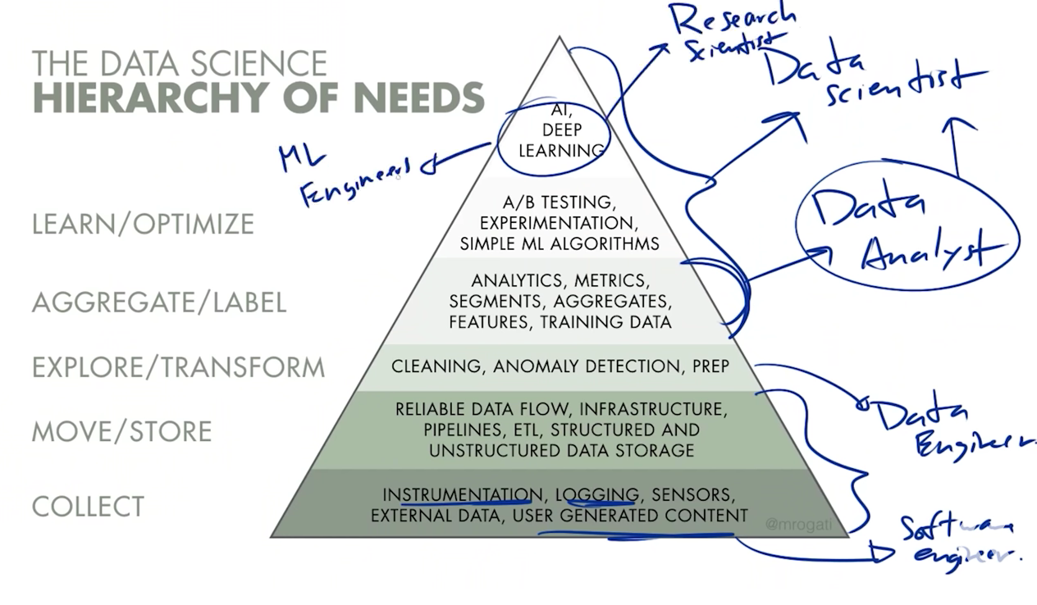
Hierarchy of Data Mining

Slide 7
Popular techniques used in Data Mining
7
Descriptive
Clustering (Database Segmentation)
Association (link analysis)
Summarisation (Statistics)
Predictive
Prediction
Classification
Regression
Regression Tree
Notes:
What they mean ?
https://bigdatanerd.wordpress.com/2011/06/25/introduction-to-data-mining-types-of-data-mining-techniques/
Descriptive analysis or statistics does exactly what the name implies they “Describe”, or summarize raw data and make it something that is interpretable by humans. They are analytics that describe the past. The past refers to any point of time that an event has occurred, whether it is one minute ago, or one year ago. Descriptive analytics are useful because they allow us to learn from past behaviors, and understand how they might influence future outcomes. All data is unlabeled and the algorithms learn to inherent structure from the input data.
Predictive analytics has its roots in the ability to “Predict” what might happen. These analytics are about understanding the future. Predictive analytics provides companies with actionable insights based on data. Predictive analytics provide estimates about the likelihood of a future outcome. It is important to remember that no statistical algorithm can “predict” the future with 100% certainty. Companies use these statistics to forecast what might happen in the future. This is because the foundation of predictive analytics is based on probabilities
One common application most people are familiar with is the use of predictive analytics to produce a credit score. These scores are used by financial services to determine the probability of customers making future credit payments on time. Typical business uses include, understanding how sales might close at the end of the year, predicting what items customers will purchase together, or forecasting inventory levels based upon a myriad of variables
The relatively new field of prescriptive analytics allows users to “prescribe” a number of different possible actions to and guide them towards a solution. In a nut-shell, these analytics are all about providing advice. Prescriptive analytics attempt to quantify the effect of future decisions in order to advise on possible outcomes before the decisions are actually made. At their best, prescriptive analytics predicts not only what will happen, but also why it will happen providing recommendations regarding actions that will take advantage of the predictions.
All data is labeled and the algorithms learn to predict the output from the input data.
Classification is a data mining function that assigns items in a collection to target categories or classes. The goal of classification is to accurately predict the target class for each case in the data.For example, a classification model could be used to identify loan applicants as low, medium, or high credit risks.
Regression is a statistical analysis technique used to estimate relationship among variables in your data which in turn leads to prediction of your response variable.
Prediction in data mining is to identify data points purely on the description of another related data value. It is not necessarily related to future events but the used variables are unknown. Generally regression analysis is used for prediction.
Clustering: A clustering problem is where you want to discover the inherent groupings in the data, such as grouping customers by purchasing behavior.
Association: An association rule learning problem is where you want to discover rules that describe large portions of your data, such as people that buy X also tend to buy Y
Supervised and unsupervised learning :https://machinelearningmastery.com/supervised-and-unsupervised-machine-learning-algorithms/

Slide 8
Clustering
A descriptive/unsupervised data analysis method. Clustering is the process of making a group of abstract objects into classes of similar objects. Clustering helps to find group of customers with similar behaviour from a given data set customer record.
K-means clustering is simple unsupervised learning algorithm. It defines 'k' sets (the point may be considered as the centre of a one or two dimensional figure), one for each cluster k ≤ n. The clusters are placed far away from each other.
A supply chain may cluster their inventory based on variables such as item sales, item product cost to find groupings to apply a supply chain strategy. One very common use is to use clustering to pre-process and label a data set and then build a classification algorithm based on the categorizations. E.g. clusters based on house price.
https://datafloq.com/read/7-innovative-uses-of-clustering-algorithms/6224
https://www.analyticsvidhya.com/blog/2016/11/an-introduction-to-clustering-and-different-methods-of-clustering/

Slide 9
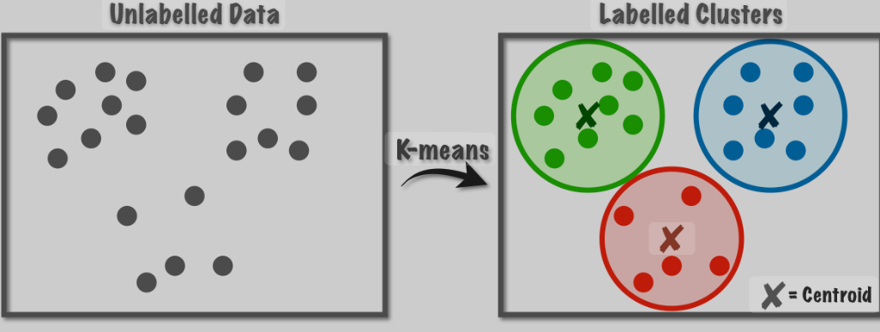
K-Mean Clustering

Slide 10
Association Method
The objects or items from relational databases, transactional databases or other information repositories are considered to find frequent patterns, associations and correlations.
Association Rules Example:
In a grocery dataset, the rule {bread, butter} → {jam} might have high confidence if jam is often purchased with bread and butter.
Association rules search for interesting relationships among the items in a given data set by examining transactions. For example - Frequently purchased item- sets can be easily found out by examining the shop cart. This helps in advertising or for placement of goods in the store.

Slide 11
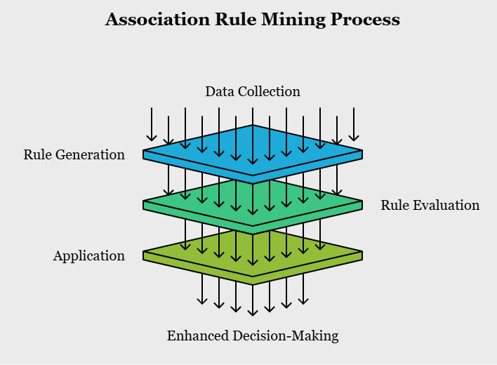
Association Method

Slide 12
Association
Let us try to understand this concept better with the help of a few examples. Suppose you are the owner of a stationary shop.
Now you get a rule: Book → Pen. This can be interpreted as: If a customer bought a book, he will also buy a pen. Let us look at another simple example.
Suppose you are analysing an online streaming website of TV series and see a rule Friends → How I met your mother. It means that people who have watched ‘Friends’ have also watched ‘How I met your mother’.
https://docs.oracle.com/cd/B28359_01/datamine.111/b28129/market_basket.htm#DMCON009

Slide 13
Classification and Regression
Regression and classification are categorized under the same umbrella of predictive/supervised machine learning. Both share the same concept of utilizing known datasets (referred to as training datasets) to make predictions.
In machine learning, regression algorithms attempt to estimate the mapping function (f) from the input variables (x) to numerical or continuous output variables (y).
For example, when provided with a dataset about houses, and you are asked to predict their prices, that is a regression task because price will be a continuous output. The decision nodes are identified to branch out classification, e.g. The price based on number of rooms and area.

Slide 14
Classification and Regression Con.
On the other hand, classification algorithms attempt to estimate the mapping function (f) from the input variables (x) to discrete or categorical output variables (y).
For example, when provided with a dataset about houses, a classification algorithm can try to predict whether the prices for the houses “sell more or less than the recommended retail price.” (based on number of rooms and location) .
Here, the houses will be classified whether their prices fall into two discrete categories: above or below the said price.
The independent variables and dependent variables are then fed to the algorithm. Apply the model to training data (outcome known). Finally retrieve predictions from the test data using the trained model.

Slide 15
Name some data mining techniques and its application in banking sector?

Slide 16
